Slide 1
CUSTOMER SEGMENTATION ANALYSIS

Slide 2

DESCRIPTIVE STATISTICS
Total expenditure: mntfishproducts + mntmeatproducts + mntfruits + mntsweetproducts + mntwines + mntgoldprods = total expenditure

Slide 3

Numdealpurchase + numstorepurchases + numwebpurchases + numcatalogpurchases = total purchases

Slide 4
 |  | Clusters
 | 1 | 2 | 3
MntFishProducts | 1 | 1 | 89
MntMeatProduct | 1725 | 3 | 708
MntFruits | 1 | 2 | 22
MntSweetProduct | 1 | 262 | 91
MntGoldProduct | 1 | 3 | 182
MntWines | 1 | 6 | 1394
NumDealsPurchases | 15 | 0 | 1
NumWebPurchases | 0 | 27 | 9
NumCagtalogPurchases | 28 | 0 | 7
NumStorePurchases | 0 | 0 | 9
NumWebVisitsMonth | 1 | 1 | 5

Slide 5
 |  | Iteration history
Iteration | 1 | 2 | 3
1 | 767.712 | 326.664 | 548.926
2 | 284.746 | 47.536 | 110.288
3 | 130.030 | 29.789 | 59.695
4 | 58.469 | 14.976 | 29.393
5 | 29.024 | 7.855 | 13.341
6 | 22.957 | 4.473 | 4.289
7 | 13.301 | 2.393 | 2.509
8 | 12.466 | 1.127 | 6.316
9 | 13.391 | 0.673 | 11.617
10 | 16.094 | 1.149 | 10.119

Slide 6
 |  | Final cluster centers
 | 1 | 2 | 3
MntFishProducts | 99 | 16 | 57
MntMeatProducts | 474 | 47 | 292
MntFruits | 66 | 12 | 40
MntSweetProducts | 68 | 12 | 43
MntGoldProducts | 77 | 28 | 70
MntWines | 453 | 103 | 875
NumDealsPurchases | 2 | 2 | 2
NumWebPurchases | 5 | 3 | 6
NumCatalogPurchases | 6 | 1 | 5
NumStorePurchases | 9 | 4 | 9
NumWebStoreVisitsMonth | 3 | 6 | 5

Slide 7
 | Numbers of cases in each cluster
Cluster 1 | 377.000
2 | 1419.000
3 | 409.000
Valid | 2205.000
Missing | 0.000

Slide 8
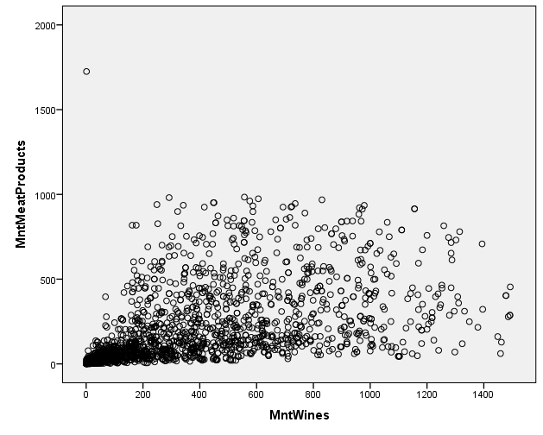
VISUALIZATION OF CUSTOMER SEGMENT

Slide 9
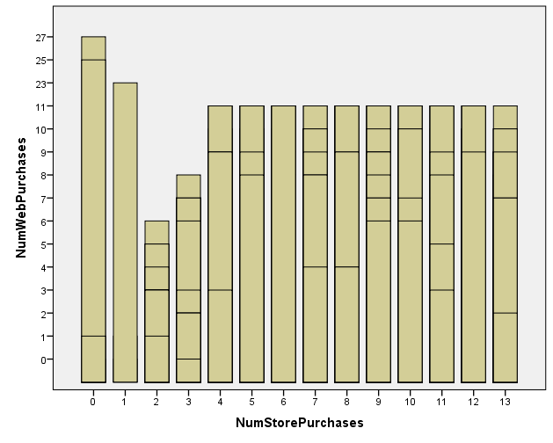

Slide 10
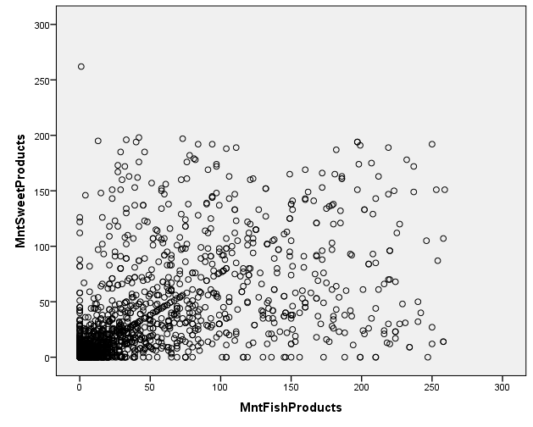

Slide 11
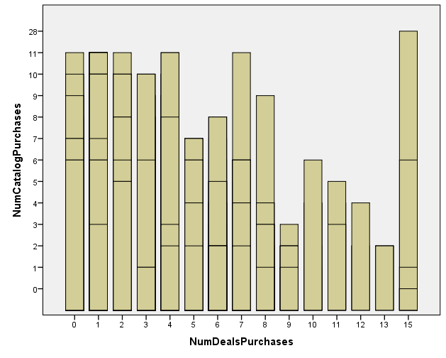

Slide 12
Based on the customer segmentation analysis, here are some recommendations tailored to each identified cluster:
Cluster 1: Deal-Sensitive, Catalog Buyers Focused on Meat Products
Personalized Promotions: Offer exclusive discounts and deals on meat products to maintain and enhance loyalty. Given their sensitivity to deals, consider implementing a loyalty program that rewards frequent purchases, particularly for catalog buyers.
Catalog and Direct Mail Campaigns: Since this cluster is inclined towards catalog purchases, continue to invest in high-quality catalog marketing. Include tailored promotions and meat product bundles to drive more sales.
Cluster 2: Sweet Product Enthusiasts Preferring Online Purchases
Online Exclusive Offers: Launch special online promotions focused on sweet products. Flash sales or limited-time offers for these items can drive urgency and boost online sales.
Email and Digital Marketing: Utilize targeted email campaigns featuring personalized recommendations for sweets and desserts. Highlight new arrivals or trending products in this category to keep customers engaged.
Subscription Services: Consider introducing a subscription box for sweets, allowing customers to receive a curated selection of products monthly, increasing customer retention and predictability of revenue.

Slide 13
Cluster 3: Premium Buyers with a Focus on Wines, Meat, and Gold Products
Premium Membership Programs: Introduce a VIP membership program offering exclusive access to premium wines, meat, and gold products. Members could receive early access to new products, invitations to special events, or personalized customer service.
In-Store Events: Host wine tasting events or gourmet cooking classes at physical stores to create an experience that resonates with this high-spending segment. Offer discounts on featured products during these events.
Luxury Product Line Expansion: Given the cluster's preference for premium products, consider expanding the luxury product line, especially in the wine and gourmet food categories. Offering limited-edition items could also appeal to this group.
General Recommendations Across Clusters:
Customer Retargeting: Implement retargeting strategies based on previous purchase behaviors. Use insights from each cluster to create ads and promotions that cater specifically to each segment's preferences.
Enhanced Data Analytics: Continuously monitor customer behavior within each cluster. Use advanced analytics to identify changes in spending patterns or emerging trends that could inform future marketing strategies.

